Slide 1
DFW High School Graduation Rate Analysis
Collaborators: Shade Petteway, Tony Veliz, Riad Tayebi, Philip May

Slide 2

What motivated our project theme:
Does independent factors have an effect on high school graduation rates?
Median Income
Divorce
Family Violence
Home Ownership
Bachelor's Degree
Notes:
So what motivated our project...The motivation behind this project sort of stemmed from the Hidden Brain Podcast: Zipcode Destiny. And from that, we wanted to take the idea and see if we could find anything interesting in our own area. We wanted to know if certain independent factors such as household income, crime levels etc., had any real relationship with the HS graduation rate in the DFW area by county.

Slide 3

Hypothesis
There is a statistical relationship between major factors and high school graduation rate.
We will reject the null hypothesis (no relationship) for each factor with:
A Pearson correlation >= +/-0.70
And an R² >= 0.50
Notes:
Independent variables: Median Income, Divorce Rate, Home Ownership Ratio, Family Violence Rates, and advanced education.
Dependent Variable: High School graduation rate
To test our hypothesis, we used correlation and regressions methods

Slide 4
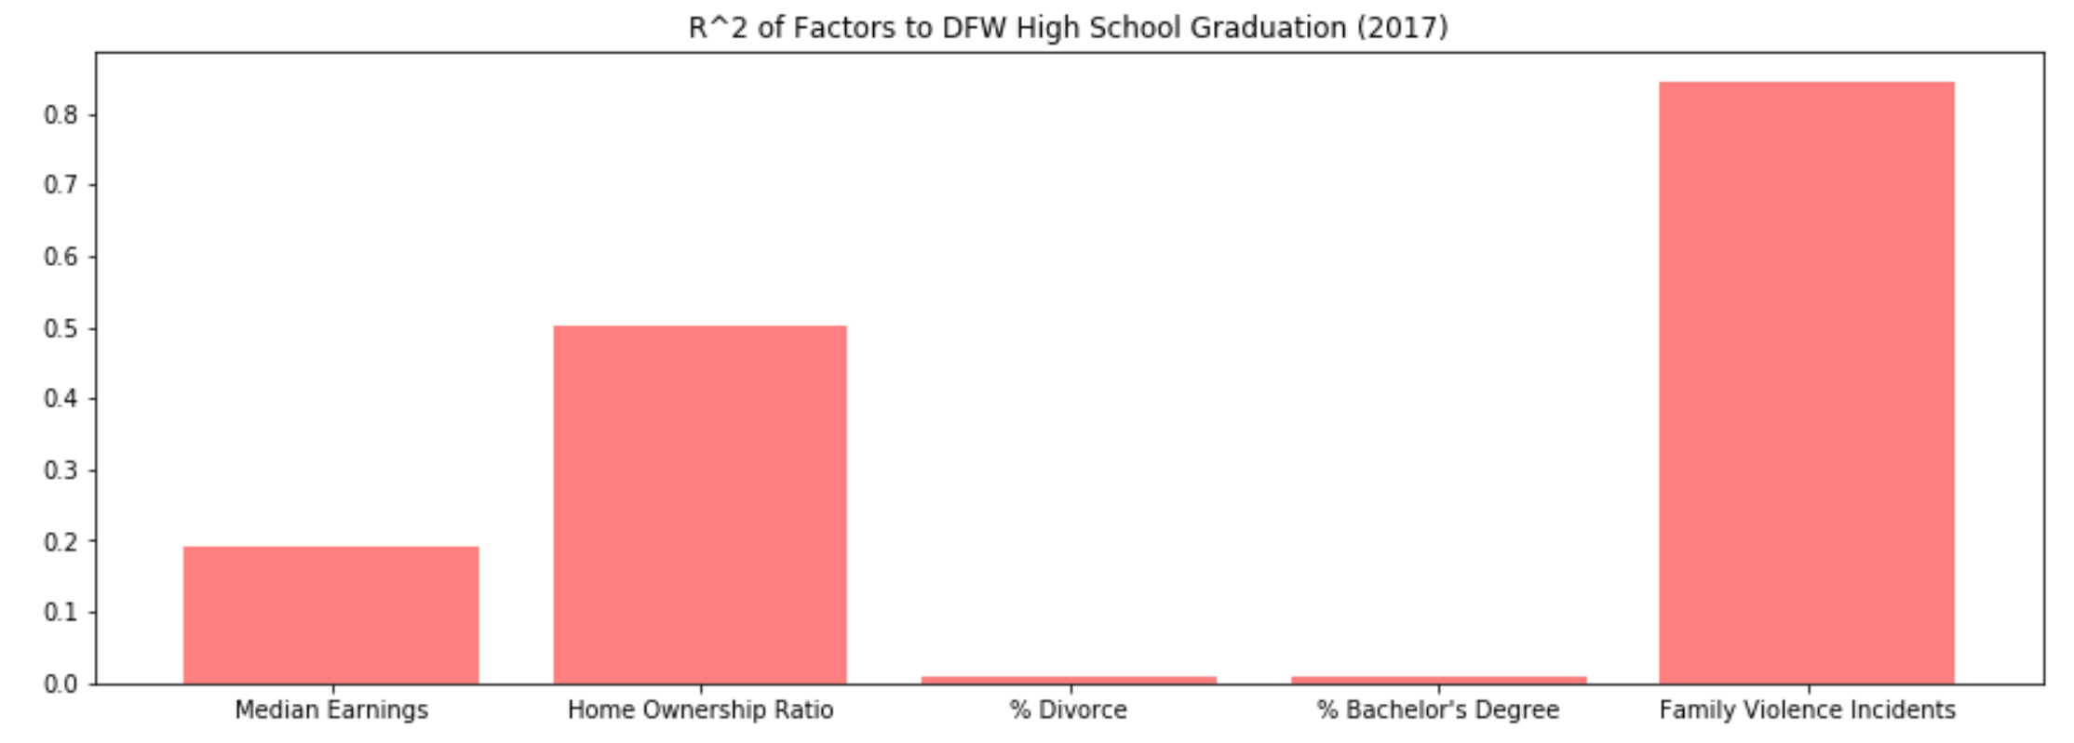
Summary of findings: What did we find?
Notes:
Reject the null hypothesis on home ownership ratio (ownership # / renter #)
Reject the null hypothesis on Family Violence Incidents as % of population
Accept the null on other factors (median earnings, divorce % of po)

Slide 5

Sources of Data
API
Demographic Data - US Census
https://www.census.gov/data/developers/data-sets/acs-1year.html
Data Set
Texas Graduation Data - Texas Education Agency
http://tea.texas.gov/acctres/completion/2017/County_Data_Download_4yr_2017
Crime Data - TxDPS
https://www.dps.texas.gov/crimereports/17/citCh10b.xlsx
Notes:
Demographic Data - US Census
Education level
Marital status
Income level
Home ownership
Graduation Data - TxDPS
High School 4 year graduation rate per race
Crime Data
Total Family violence per county

Slide 6
Data Cleanup & Exploration
Exploration and cleanup process:
Graduation rate data (TEA) by county, so filtered Census API and TxDPS csv data to relevant DFW counties only
Merged datasets by county
Adjusted for naming format/convention
Excluded one county not found in all sets (Sommerville County)

Slide 7
Data Cleanup & Exploration
Problems that arose after exploring the data:
Determining comparable location metric (county vs. zip codes, etc.)
Determining comparable time data sets (same end month or year)
Determining if race category methodologies were the same between
No Somerville in Census data (13th county) … needed to adjust in other sources
Determining what metric to use for criminal factor? Family violence vs. other
Determining what metrics to use for demographic factors?
Notes:
In addition, here are some of the problems that arose: Determining comparable location metrics (county vs zip codes) also determining comparable time data sets ;. and some of the Census API data we needed for certain counties we needed to pull from other sources. (Websites , csv files etc.) Determining what metric to use for criminal factors? Such as Family violence vs other types of violence; and determining what metrics to use for demographic factors.

Slide 8
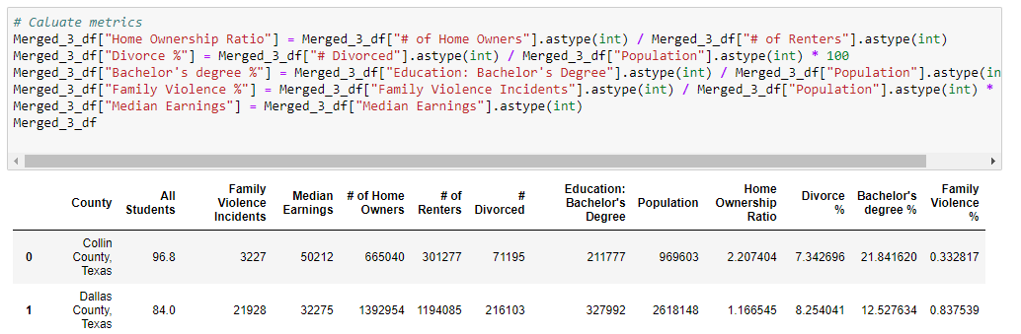
Data Cleanup & Exploration
Examples:
____
Notes:
Let’s move on to some this part of our code where it was more of a challenge to get a true representation of the data,
For example, we were not getting accurate measurements on our scatter plots. So going back through our code we noticed we needed to change the format, from it being a string to an integer. So as you see here in the columns we needed to add the .astype(int) to the end of the columns. In doing so, we managed to get a more accurate representation in our scatter plots as you will see in the next few slides. Philip here will take you through that Data Analysis part

Slide 9
Data Analysis
Steps taken to analyze the data:
Utilized three data sets
Selected common field
Merged three data sets into one dataframe
Assessed linear relationships
Notes:
45 secs

Slide 10
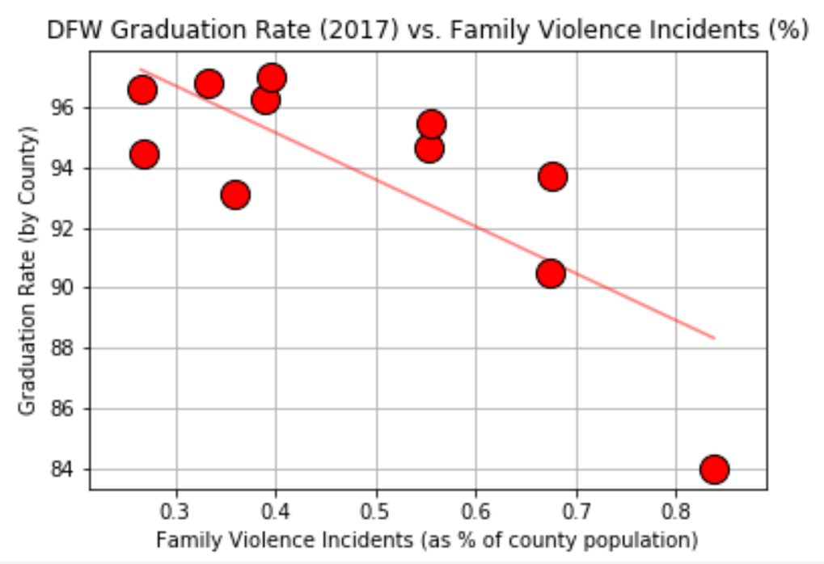
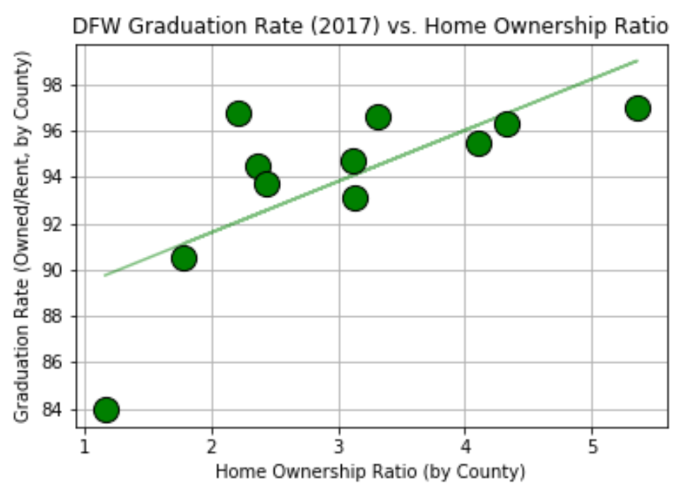
Data Analysis (cont.)
Scatter plots with strong relationships:
Notes:
25 sec

Slide 11
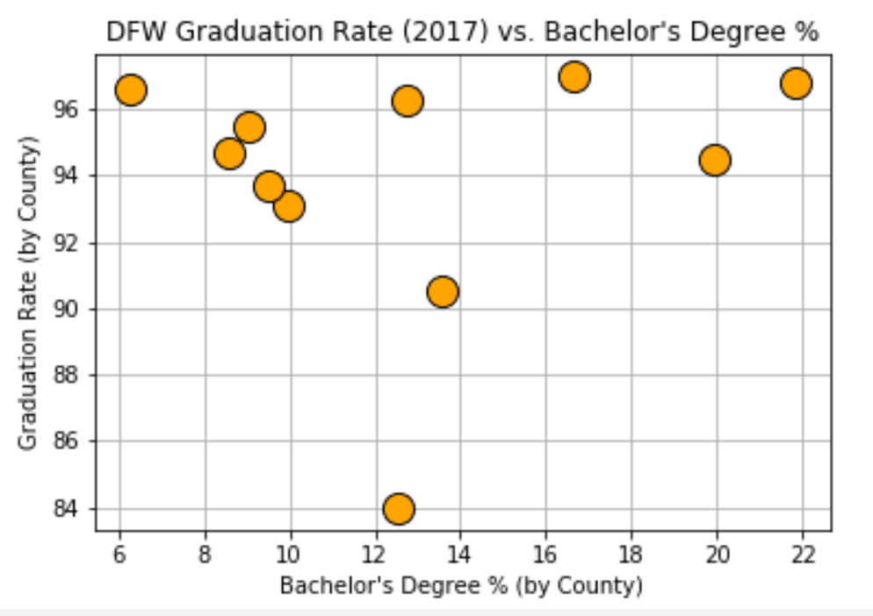
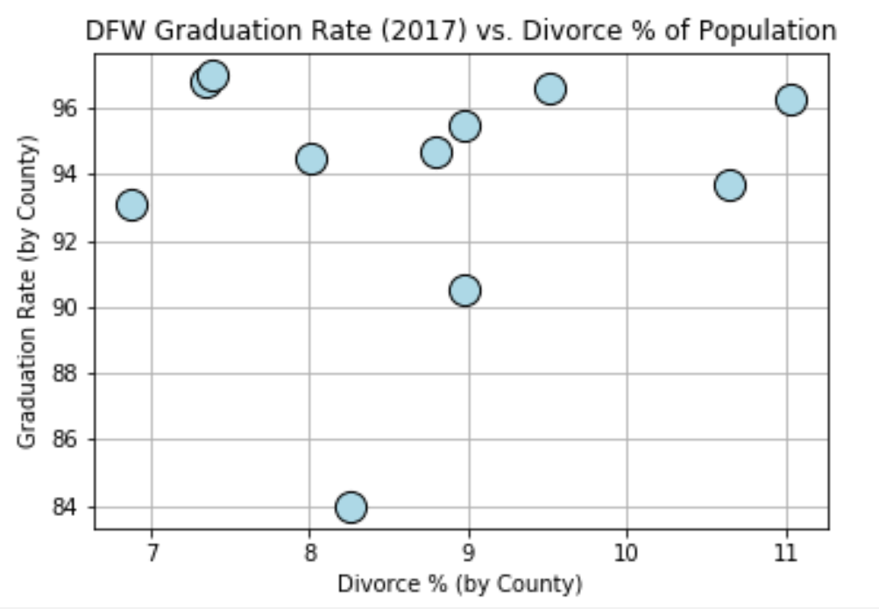
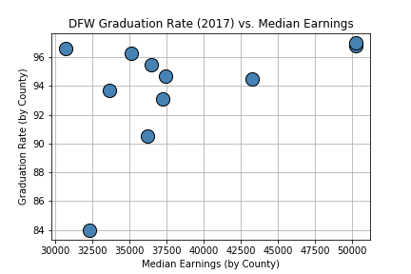
Data Analysis (cont.)
Scatter plots with weak relationships:
Notes:
10 secs

Slide 12
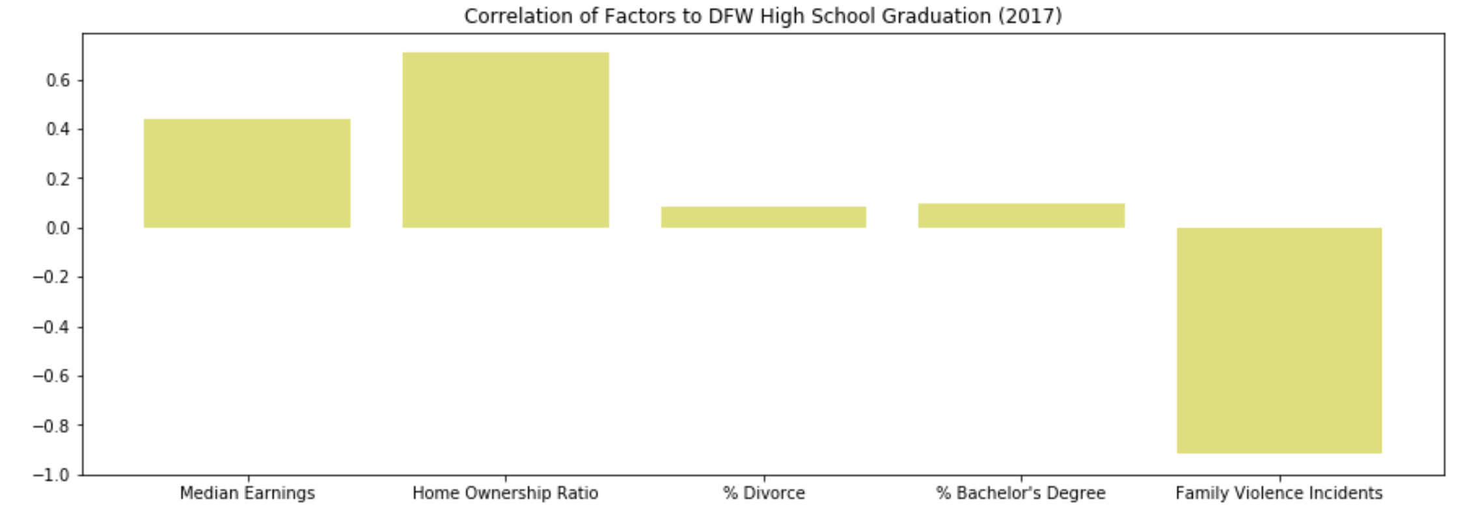
Data Analysis (cont.)
Correlation summary:
Notes:
35 secs

Slide 13
Data Analysis (cont.)
R-Squared Summary:
Notes:
15 secs

Slide 14
Findings
We were surprised by some findings
General conclusion: Strong relationship between FVI/graduation rate and home value ratio/graduation warrants further investigation
Notes:
30 secs

Slide 15
Post Mortem
How we would proceed with additional time: Deeper dive into the family violence/ high school graduation rate relationship
Notes:
45 secs

Slide 16
Post Mortem (cont.)
Difficulties that arose: Data collection and exploration
How we dealt with them: Started with a narrow focus
Notes:
30 secs

Slide 17
Any questions?

Slide 18
Thank you for your time

